Slide 1
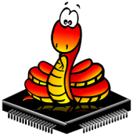
PROGRAMMING ESP-8266 & ESP-32 WITH MICROPYTHON

Slide 2
INTRODUCTION TO PROGRAMMING BOARDS

Slide 3
ESP-8266 or NodeMCU

Slide 4
ESP-8266 PWM

Slide 5
KEY FEATURES OF ESP8266 NODEMCU :
Microcontroller : 32-bit Tensilica processor
Clock Speed : 80 MHz
USB Converter : CP2102
USB Connector : Micro USB
Operating Voltage : 3.3V
Flash Memory : 4 MB
Digital I/O : 11
Analog Inputs : 1
Communications : Serial, SPI. I2C and 1-Wire via software libraries
Wi-Fi : Built-in 802.11 b/g/n

Slide 6
ESP-32

Slide 7
KEY FEATURES OF ESP32-S DEVELOPMENT BOARD:
Microcontroller : Xtensa LX6 32-bit
Clock Speed : 160MHz
USB Converter : CP2102
USB Connector : Micro USB
Flash Memory : 4 MB
RAM : 512Kb
Digital I/O : 32 (26 usable)
PWM : 16 channels
Analog Outputs : 2 channels, 8-bit
Analog Inputs : 16 channels, 12-bit

Slide 8
Communications : 3 Serial, 4 SPI, 2 I2C, CAN bus, I2S Stereo
Integrated Sensors : IR remote, Hall sensor, temperature sensor, touch sensors, pulse counter
Bluetooth : 4.2 and BLE (Bluetooth Low Energy)
Wi-Fi : Built-in 802.11 b/g/n 2.4GHz
Buttons : EN (Reset) and IO0 (Boot)
Programming : Compatible with Arduino IDE
Pin Spacing : 0.1″ centers. Breadboard compatible
Operating Voltage : 3.3V internal power and I/O. 5V-9V external power with on- board regulator

Slide 9
GETTING THE BOARD READY FOR PROGRAMMING
Go to https://micropython.org
Go to downloads and check for the board firmware.
Under Espressif ESP-based boards press Generic 8266 module for Esp8266 and click esp8266-20200911-v1.13.bin (elf, map) (latest) for download
For ESP32 press Generic ESP32 module and click esp32-idf3-20200902-v1.13.bin for download
Go to Tools > Options and select the Interpreter tab.
Choose MicroPython (ESP8266)/ MicroPython (ESP32).
Then, select your device serial port .
Then click Firmware button and upload the firmware.
Now go back and press reset button on your board. The following will be displayed.

Slide 10
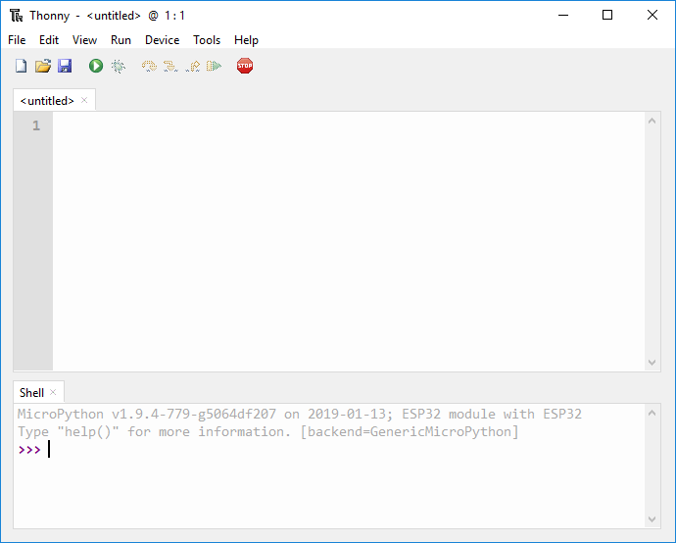

Slide 11
BASIC PROGRAMMING WITH ESP8266

Slide 12
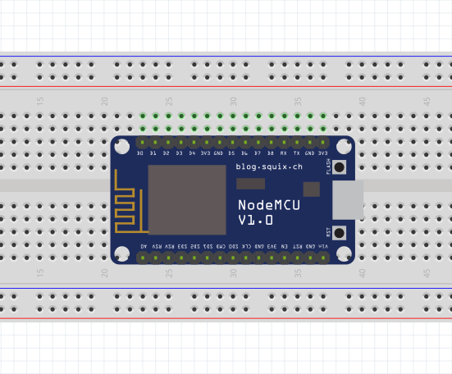
01-Blinking an inbuilt LED on ESP8266

Slide 13
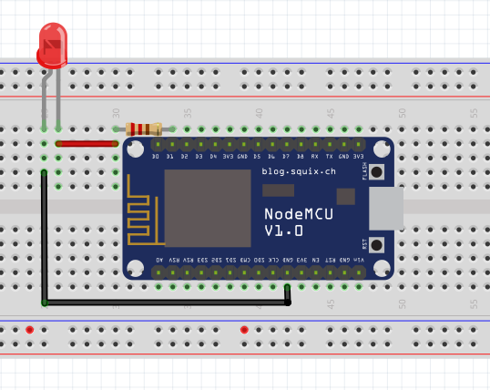
02-GPIO: Programming
Blinking an LED connected to a GPIO pin 5

Slide 14
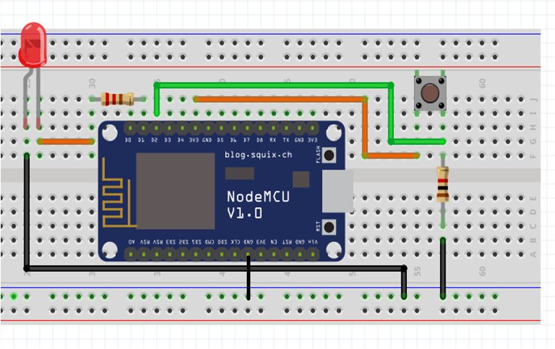
Push Button for LED control

Slide 15
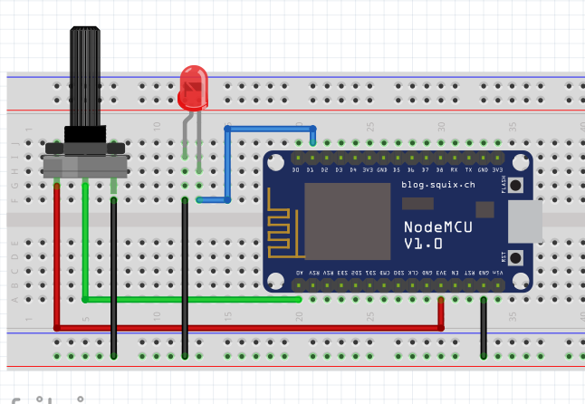
LED blink control using Potentiometer

Slide 16
03-PWM(Pulse Width Modulation)
Basic PWM concept

Slide 17
PWM - LED Glow control(led fade)

Slide 18
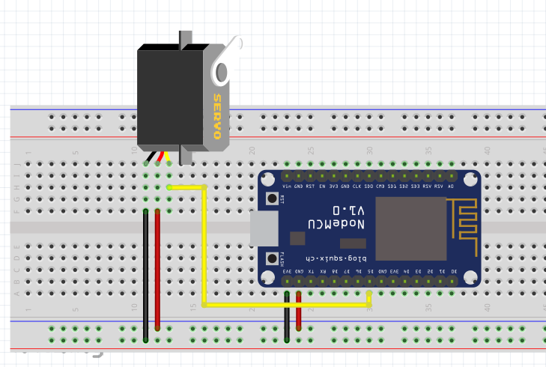
PWM –Servo motor control

Slide 19
04- ADC (Analog to Digital Converter)
ADC –LED blink control using Potentiometer

Slide 20
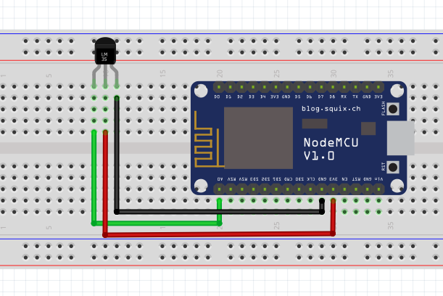
ADC–LM35 Temperature Sensor Interfacing

Slide 21
05-I2C COMMUNICATION
I2C helps to connect multiple slaves to a single master and you can have multiple masters controlling single, or multiple slaves.
I2C Bus (Interface wires) consists of Serial Clock Line (SCL) and Serial Data Line (SDA).
The data to be transferred is sent through the SDA wire and is synchronized with the clock signal from SCL.

Slide 22
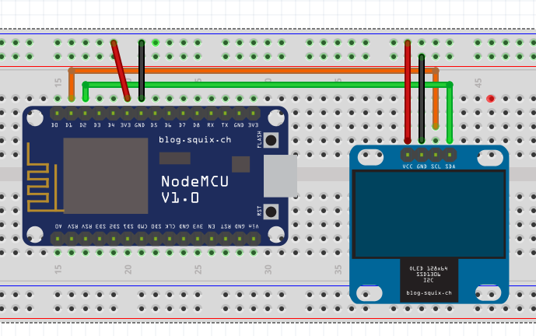
OLED Interface using I2C

Slide 23
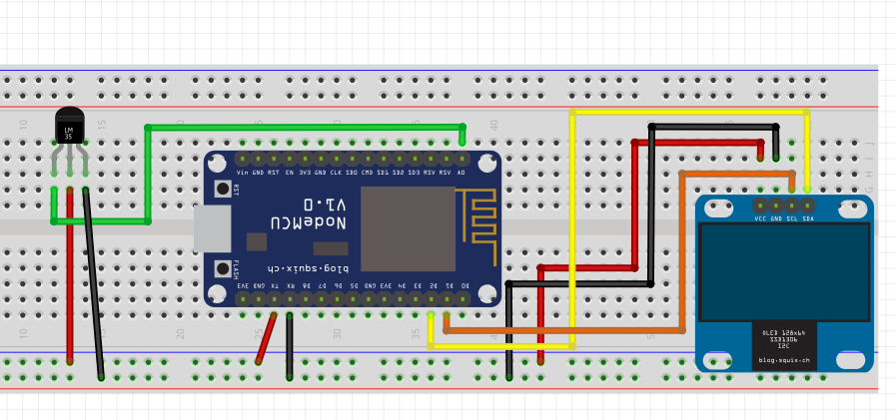
LM35 Interface using I2C

Slide 24
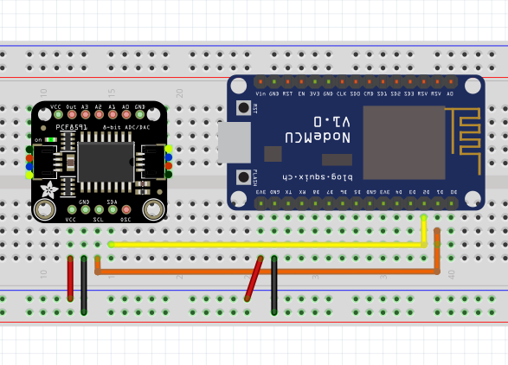
PCF8591 Interface using I2C

Slide 25
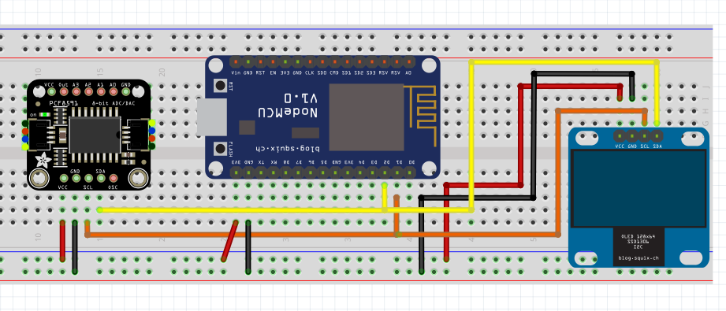
OLED and PCF8591 Interface using I2C

Slide 26
06-UART COMMUNICATION
In a UART communication scheme:
One chip’s Tx (transmit) pin connects directly to the other’s Rx (receive) pin and vice versa. Commonly, the transmission will take place at 3.3 or 5V.
UART is a single-master, single-slave protocol, where one device is set up to communicate with only one partner.
When sending on the Tx pin, the first UART translates this parallel information into serial and transmits it to the receiving counterpart.
The second UART receives this data on its Rx pin and transforms it back into parallel to communicate with its controlling device.

Slide 27
UARTs transmit data serially, in one of three modes:
Full duplex: Simultaneous communication to and from each master and slave
Half duplex: Data flows in one direction at a time
Simplex: One-way communication only

Slide 28
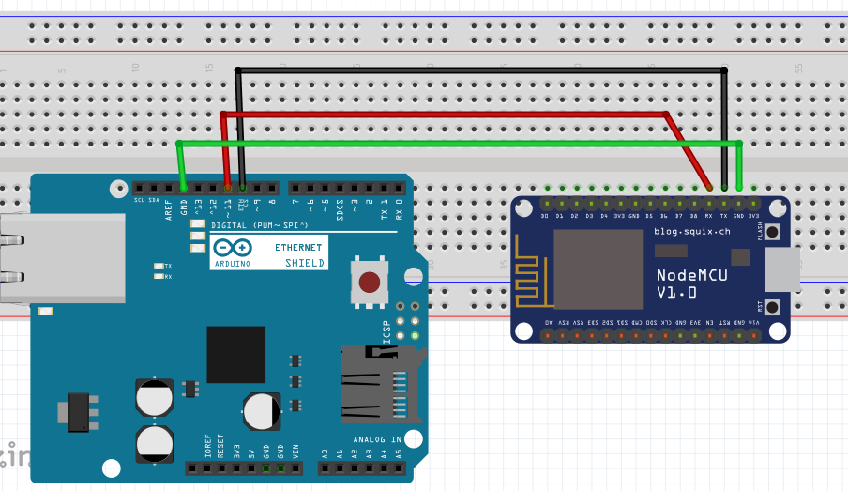
UART Communication between Arduino Uno and ESP8266

Slide 29
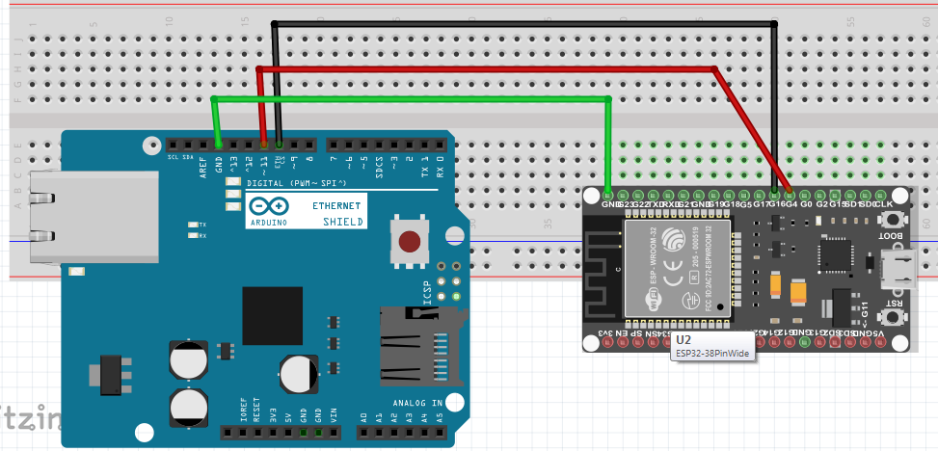
UART Communication between Arduino Uno and ESP-32

Slide 30
07-WEB REPL
Web REPL allows you to use the Python prompt over Wi-Fi, connecting through a browser.
WebREPL client is hosted at http://micropython.org/webrepl .
Alternatively, one can install it locally from the the GitHub repository https://github.com/micropython/webrepl .
To enable the WebREPL on the board use the following command
import webrepl_setup

Slide 31
For ESP32 we need to incorporate this in boot.py
def do_connect(ssid, pwd):
import network
sta_if = network.WLAN(network.STA_IF)
if not sta_if.isconnected():
print('connecting to network...')
sta_if.active(True)
sta_if.connect(ssid, pwd)
while not sta_if.isconnected():
pass
print('network config:', sta_if.ifconfig())
# This file is executed on every boot (including wake-boot from deepsleep)
#import esp
#esp.osdebug(None)
# Attempt to connect to WiFi network
do_connect('JioFi3_564B6F', 'x6mbnn9sz7')

Slide 32
08-DEEP SLEEP CONCEPT OF ESP8266 & ESP32
TYPES OF SLEEP in esp-8266
There are four types of sleep modes for the ESP8266:
No-sleep: The No-Sleep setting will keep everything on at all times.
Modem-sleep: Modem-sleep is the default mode for the ESP8266. However, it's only enabled when you're connected to an access point rest of the time wi-Fi is switched off.
Light-sleep: Light-sleep performs the same function as Modem-sleep, but also turns off the system clock and suspends the CPU. The CPU isn't off; it's just idling.
Deep-sleep: Everything is off but the Real Time Clock (RTC), which is how the computer keeps time. Since everything is off, this is the most power efficient option.

Slide 33
RTC based ESP8266 Deep Sleep and Awake Process

Slide 34
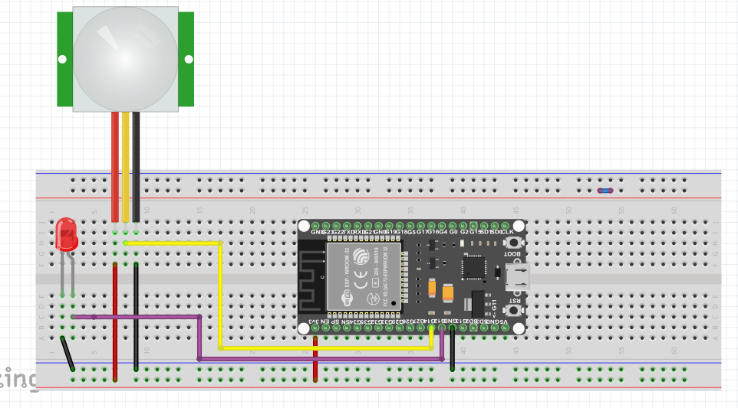
ESP-32 PIR Sensor(passive infrared sensor) based led trigger and display(Deep sleep )

Slide 35
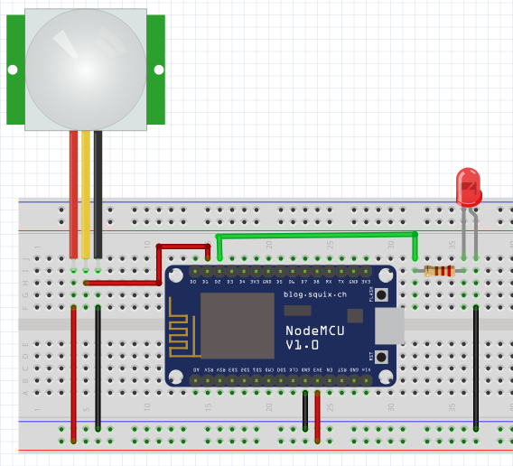
09- PROJECTS
PIR Sensor(passive infrared sensor) based led trigger(Normal/interrupt method)

Slide 36
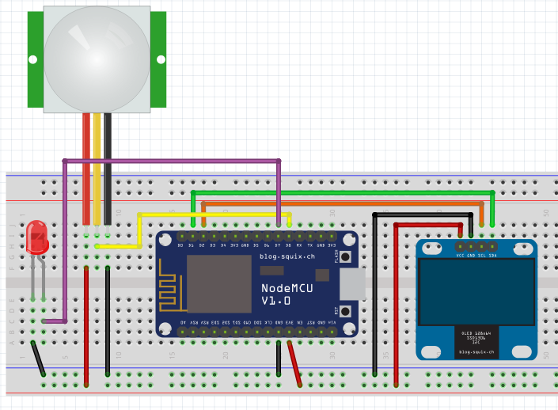
PIR Sensor(passive infrared sensor) based led trigger and display(interrupt method)

Slide 37
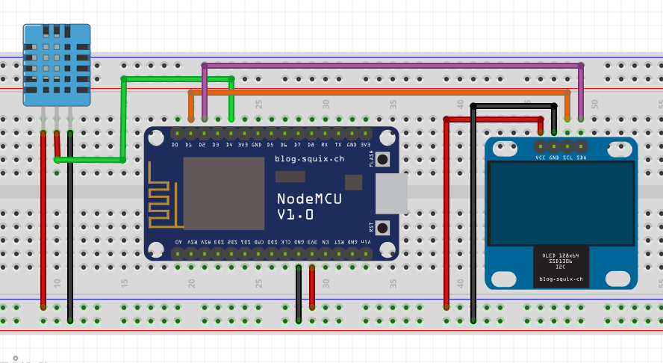
DHT-11 Temperature and Humidity monitoring using OLED

Slide 38
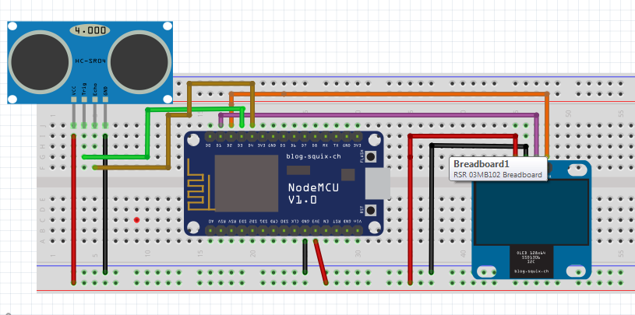
HC-SR04 Sensor based distance measuring

Slide 39
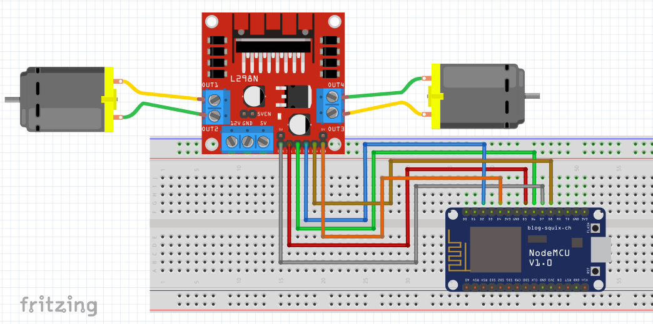
ESP 8266 DC motor control

